Slide 1
Multidimensional Visualization of Online Discourse
Florian Rauls

Slide 2
Microblogging Services
Microblogging services are a key part of social media platforms
Topics include:
Politics
Science
Culture

Slide 3

Twitter Terminology: Tweet
Short message
From a user
Topic through #

Slide 4
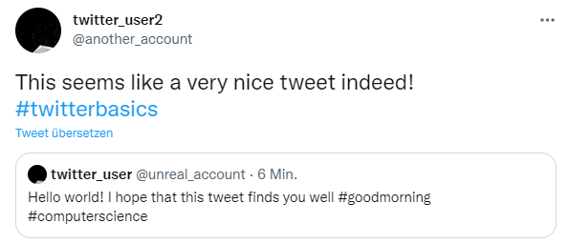
Twitter Terminology: Retweet
Tweet
Reacts to ONE specific tweet
One-to-many: Lots of users can react to one single Tweet

Slide 5
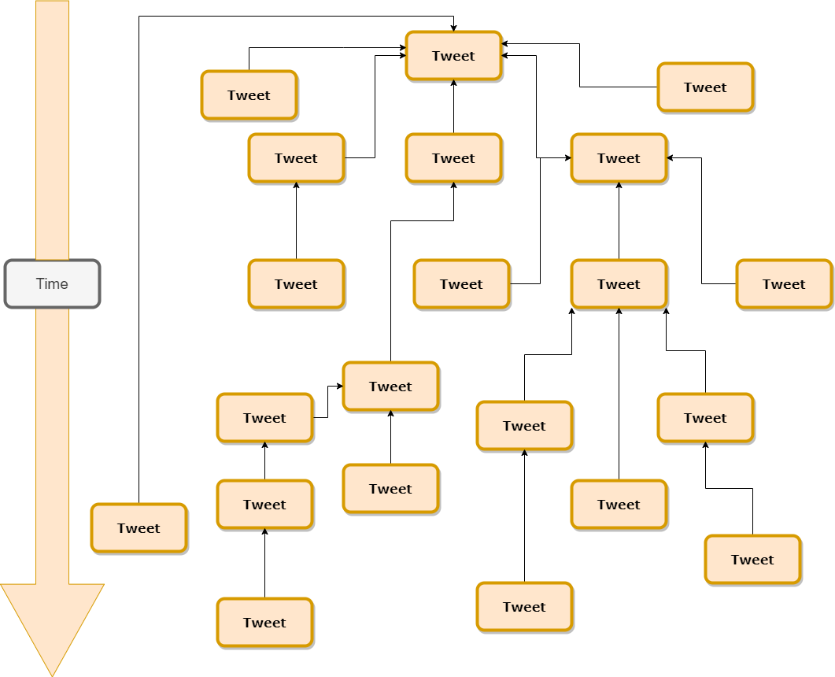
Our Terminology: Tweet Tree
Nodes are Tweets
Edges are Tweet-Retweet relationships
Any children are Retweets to their parents
Time from top to bottom
Visual representation of conversations

Slide 6
Problem Description
One-to-many relationship leads to complexity
No “bigger picture”
Analysis of flow of conversation only possible through text-by-text analysis
→ Discourse Analysis becomes very difficult!

Slide 7
Idea
Collect data from Twitter
Pre-process data
Add extra dimensions (if of interest)

Slide 8
Idea
Reduce complexity
Show a broad overview
Allow for answering of complex questions

Slide 9
Our Terminology: Conversational Thread
Any subset of the Tweet Tree
WITHOUT bifurcation

Slide 10
Related Work
Tornberg et al. used topic modeling for discourse analysis
McKelvey et al. used diffusion networks to show relations between different users on Twitter
Scharl et al. try to visualize different textual dimension of online discourse through a multitude of plots

Slide 11
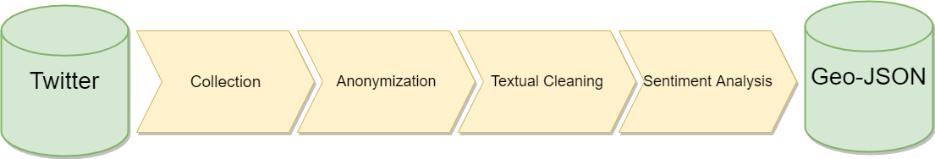
Data Preparation

Slide 12
Data Preparation

Slide 13
Data Preparation Collection/Anonymization
Collection:
We used tweets which are associated with the COVID-19 pandemic*
Download data via official Twitter-API
Only retain tweets which:
Do have a geo-location
Do have a timestamp
Anonymization:
Exchange username with randomized ID
Users with multiple tweets should have the same ID
* https://dataverse.harvard.edu/dataset.xhtml?persistentId=doi:10.7910/DVN/LW0BTB

Slide 14
Data Preparation

Slide 15
Data Preparation: Textual Cleaning
Remove punctuation
Emojis
Any other non-alphanumerical token

Slide 16
Data Preparation

Slide 17


Data Preparation: Sentiment Analysis
0
1
*based on the outputs of a state-of-the-art transformer network

Slide 18
Storage
We store our data in Geo-JSON file format
Key(Country):
Entry(Geometrical data (for country borders))
Entry(List of messages):
Key(Message ID):
Entry(Text)
Entry(Time)
Entry(Sentiment)
…

Slide 19
Visualization Preparation
Read the Geo-JSON
Write each message into an object
Derive location of each object by
X and Z coordinates from the message’s state
Y $=index_{message in state}+offset$
Y =𝑖𝑛𝑑𝑒𝑥_(𝑚𝑒𝑠𝑠𝑎𝑔𝑒 𝑖𝑛 𝑠𝑡𝑎𝑡𝑒)+offset
→ Rigid pattern of evenly spaced messages

Slide 20
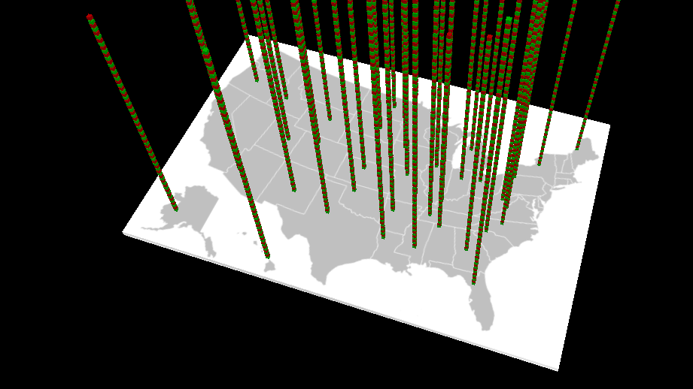
Location

Slide 21
Time
Location

Slide 22
Visualization
3D-render a cube object for each message-object
For coordinates use the computed ones from before
Color the message according to dimension of choice
E.g. sentiment of message text
On selection:
Display meta-information about message (location, time, sentiment…)
If selected message is an answer to another question:
Connect the two corresponding objects via an arrow
If corresponding message is answer as well: repeat
Display aggregate statistics
Display UI for filter options

Slide 23
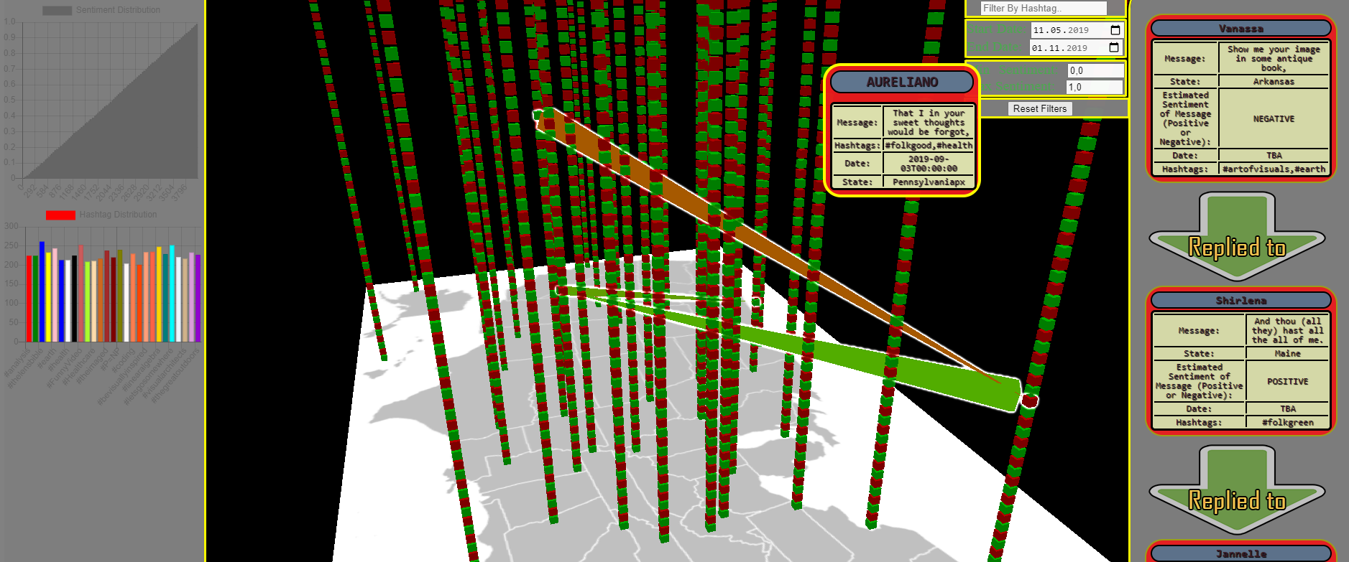

Slide 24
Limitations
Method runs into RAM issues fast
→ Streaming of data
Twitter-API is a bottleneck for loading messages
→ pre-load a lot of data
Meaningful rendering of messages is limited to ~1000
→ Clustering of messages

Slide 25
Conclusion
We introduced a novel scheme for rendering diverse discussion threads on microblogging platforms
Multi-dimensional data can be displayed
Allows for the answering of research questions
Proposal of pipeline for data collection and preparation
Possible Improvements:
Solving of RAM issue through data streaming
Better display quality through clustering of messages
Possible visualization schemes for flow/changes of topics during conversations

Slide 26
Short Presentation

Slide 27
Thank you for your attention!
Florian Rauls

